Slide 1
Lecture # 13
Regular Language
Complement of Language
Theorem
Non-regular Language

Slide 2
Regular languages
As already been discussed earlier that any language that can be expressed by a RE is said to be regular language, so if L₁ and L₂ are regular languages then L₁ + L₂ , L₁L₂ and L₁* L₂ are also regular languages. This fact can be proved by the following two methods

Slide 3
Complement of Language
Let L be a language defined over an alphabet Σ, then the language of strings, defined over Σ, not belonging to L, is called Complement of the language L, denoted by L^{c} or L’.
Note
To describe the complement of a language, it is very important to describe the alphabet of that language over which the language is defined.
For a certain language L, the complement of L^{c} is the given language L i.e. (L^{c})^{c} = L

Slide 4
Theorem
If L is a regular language then, Lc is also a regular language.
Proof
Since L is a regular language, so by Kleene’s theorem, there exists an FA, say F, accepting the language L. Converting each of the final states of F to non-final states and old non-final states of F to final states, FA thus obtained will reject every string belonging to L and will accept every string, defined over Σ, not belonging to L. Which shows that the new FA accepts the language L^{c}. Hence using Kleene’s theorem L^{c} can be expressed by some RE. Thus L^{c} is regular.

Slide 5
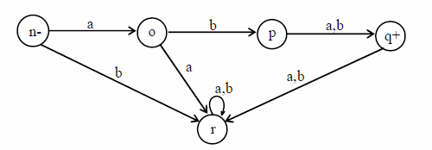
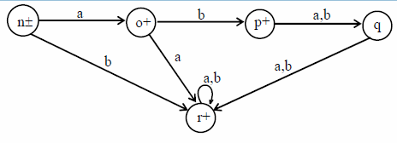
Example
Let L be the language over the alphabet Σ = {a, b}, consisting of only two words aba and abb, then the FA accepting L may be
Converting final states to non-final states and old non-final states to final states, then FA accepting L^{c} may be

Slide 6
Non-regular Languages
The language that cannot be expressed by any regular expression is called a Nonregular language. The languages PALINDROME and PRIME are the examples of nonregular languages.
Note: It is to be noted that a nonregular language, by Kleene’s theorem, can’t be accepted by any FA or TG.

